Slide 1
TA Session for Chapters 3-4
Ho Chi Minh City University of Technology
Faculty of Computer Science and Engineering
Database Management Systems (CO3021)
Computer Science Program
Assoc. Prof. Dr. Võ Thị Ngọc Châu
(chauvtn@hcmut.edu.vn)
Semester 2 – 2022-2023

Slide 2
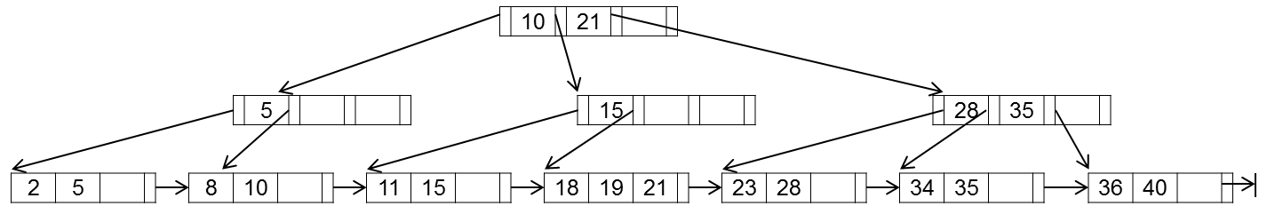
Question 17
Given a data file of Project records with the following schema:
Project (Pnumber, Pname, Plocation, Pdepartment),
where Pnumber is the primary key.
Also given a B+-tree (p=4, p_{leaf}=3), which is a secondary index on Pnumber.
17.1. How is the given B+-tree updated after the statement is successfully executed?
DELETE FROM Project
WHERE Pnumber = 23;
17.2. How is the given B+-tree updated after the statement is successfully executed?
INSERT INTO Project (Pnumber, Pname, Plocation, Pdepartment)
VALUES (20, 'Manufacturing', 'New York', 5);
17.3. How many block accesses are needed to process the query using the index on Pnumber?
SELECT *
FROM Project
WHERE Pnumber = 19;

Slide 3
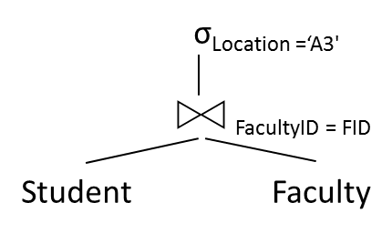
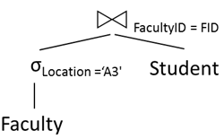
Question 18
Given two data files about students and faculties with the following schemas where SID is the primary key of Student, FID is the primary key of Facuty, FacultyID is the foreign key of Student referring to FID of Faculty.
Student (SID, Fname, Lname, Bdate, Gender, Hometown, Contact, EntranceYear, FacultyID)
Faculty(FID, Fname, Location, EstablishedYear)
Statistical information about these two files is given as follows:
Student has:
- r_{S} = 51,000 records
- b_{S} = 17,000 blocks
- bfr_{S} = 3 records/block
- A primary index on SID: x_{SID} = 4, s_{SID} = 1
- A secondary index on FacultyID: x_{FacultyID} = 2, s_{FacultyID} = 2,500
Faculty has:
- r_{F} = 18 records
- b_{F} = 5 blocks
- bfr_{F} = 4 records/block
- A primary index on FID: x_{FID} = 1, s_{FID} = 1
- A secondary index on Location: x_{Location} = 2, s_{Location} = 3
18.1. Given a query tree. What SQL query is equivalent to the given tree?
18.2. Determine an execution plan of the given query tree in Question 18.1 using cost-based optimization. What is its total cost? Given that the blocking factor of the join result is 2 records/block and the buffer is 3 blocks large.
18.3. Is the 2nd query tree better than the one given in Question 18.1? Explain your answer.
(18.1)
(18.3)

Slide 4

Database Management Systems (CO3021)

